Slide 1
Use Case 1: Add New System
Use Case UC-1: |  |  | Add New System
Related Requirements: |  |  | REQ3, REQ5, REQ7, REQ9, REQ11
Initiating Actor: |  |  | Any of: Trusted Users, Admin
Actor’s Goal: |  |  | To add information for a new system to the repository
Participating Actors: |  |  | Database, Admin, Trusted Users
Preconditions: |  |  | Trusted User/Admin is currently logged in the system and is shown a hyperlink “Add New System.”
Postconditions: |  |  | The newly added system is now viewable to all visitors of the site
Flow of Events for Main Success Scenario:
→ | 1. | Trusted User/Admin clicks the hyperlink “Add New System”
← | 2. | System prompts the Trusted User/Admin for the Name, Version Control System URL, Issue Tracker URL, and Programming Language of the System
→ | 3. | Trusted User/Admin enters the system information and clicks submit
← | 4. | System updates the records in the Database
→ | 5. | System displays the updated information on the “View Systems” page

Slide 2
Use Case 2: View Systems
Use Case UC-1: |  |  | Add New System
Related Requirements: |  |  | REQ4, REQ6, REQ8, REQ10, REQ12
Initiating Actor: |  |  | Any of: Trusted Users, Public Users, Admin
Actor’s Goal: |  |  | To view information about the systems stored within the repository
Participating Actors: |  |  | Database, Admin, Trusted Users, Public Users
Preconditions: |  |  | Trusted User/Admin/Public User currently has access to the system and is shown a “View Systems” Hyperlink
Postconditions: |  |  | The systems information table of the database is viewable to all visitors of the site
Flow of Events for Main Success Scenario:
→ | 1. | Trusted User/Admin/Public User clicks the hyperlink “View Systems”
→ | 2. | System displays the most up to date information on the “View Systems” page

Slide 3
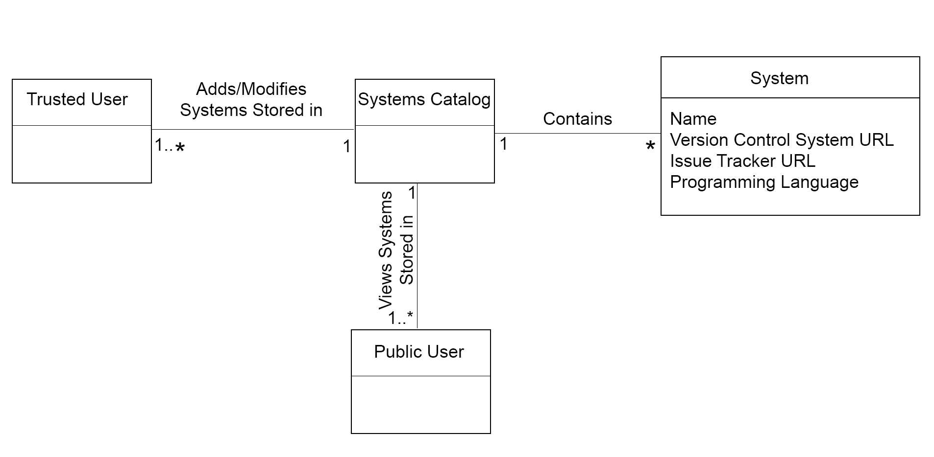
Domain Model

Slide 4
Use Case 3: Add New System Release
Use Case UC-1: |  |  | Add New System
Related Requirements: |  |  | REQ1, REQ5, REQ7, REQ9, REQ11
Initiating Actor: |  |  | Any of: Trusted Users, Admin
Actor’s Goal: |  |  | To add release information for a system stored within the repository
Participating Actors: |  |  | Database, Admin, Trusted Users
Preconditions: |  |  | Trusted User/Admin is currently logged in the system and is shown a hyperlink “Add New System Release.”, Previous release of the system already exist within the System information table
Postconditions: |  |  | The newly added system release is now viewable to all visitors of the site
Flow of Events for Main Success Scenario:
→ | 1. | Trusted User/Admin clicks the hyperlink “Add New System Release”
← | 2. | System prompts the Trusted User/Admin for the System Name and System Release of the System
→ | 3. | Trusted User/Admin enters the system information and clicks submit
← | 4. | System verifies that a previous release of the system is present within the “System Information” table
← | 5. | System updates the records of the “System Release” table in the Database
→ | 6. | System displays the updated information on the “View Systems” page

Slide 5
Use Case 2: View System Releases
Use Case UC-1: |  |  | Add New System
Related Requirements: |  |  | REQ4, REQ6, REQ8, REQ10, REQ12
Initiating Actor: |  |  | Any of: Trusted Users, Public Users, Admin
Actor’s Goal: |  |  | To view information about the release of a system stored within the repository
Participating Actors: |  |  | Database, Admin, Trusted Users, Public Users
Preconditions: |  |  | Trusted User/Admin/Public User currently has access to the system and is shown a “View System Release” Hyperlink
Postconditions: |  |  | The systems information table of the database is viewable to all visitors of the site
Flow of Events for Main Success Scenario:
→ | 1. | Trusted User/Admin/Public User clicks the hyperlink “View System Release”
→ | 2. | System displays the most up to date information on the “View System Release” page

Slide 6
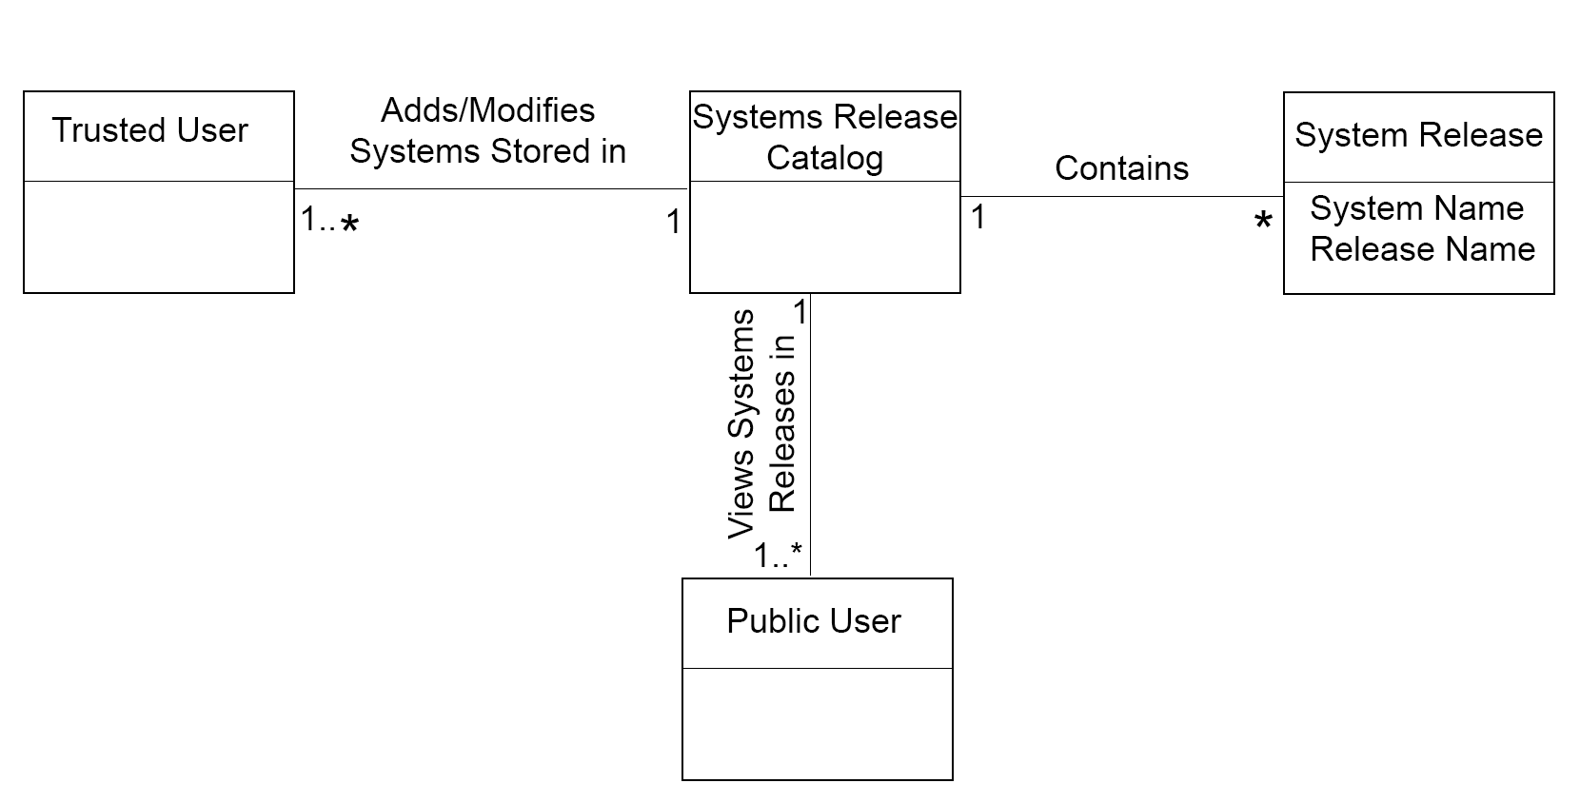
Domain Model

